Slide 1

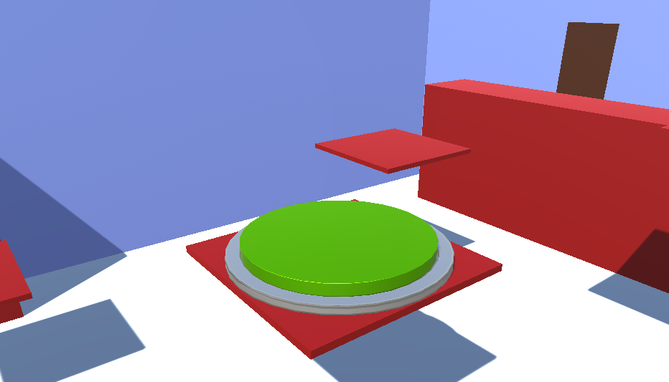
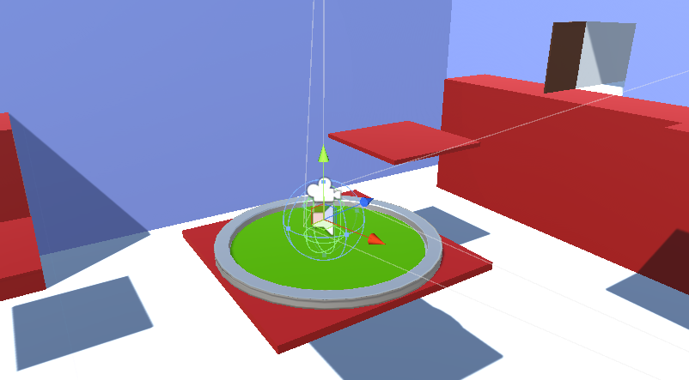
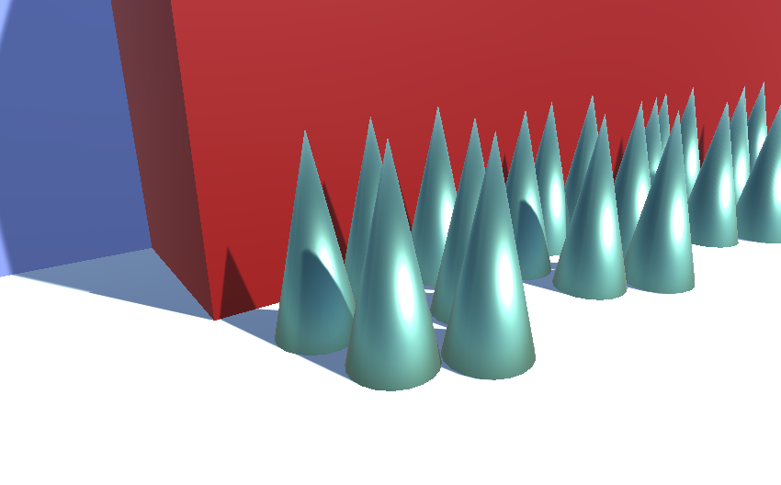


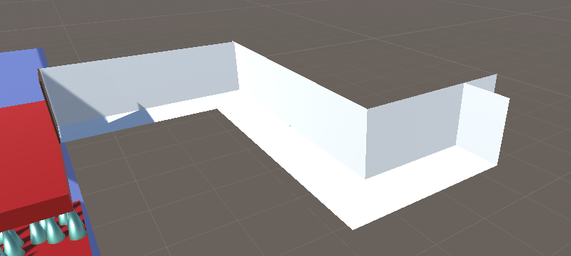
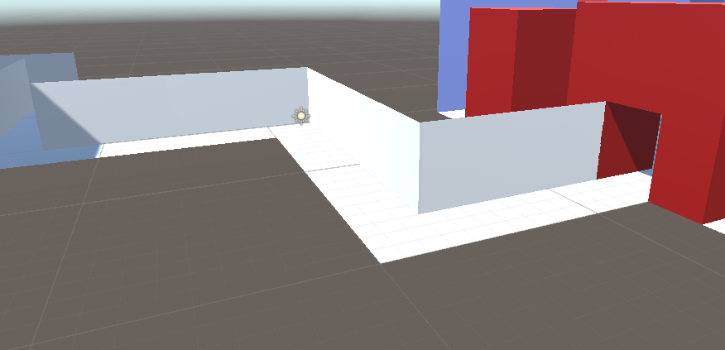
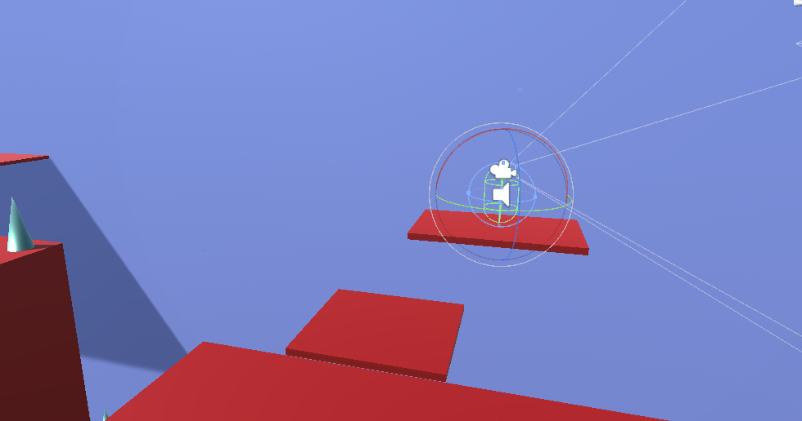
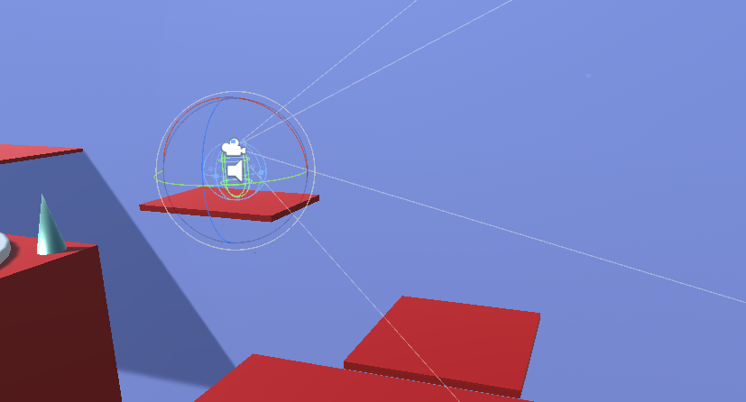
You can run.You can jump. And you can die.
Interrobang is a game.
But not just any game.
Its a 3D platformer.
You can run.
You can jump.
And you can die.
Interrobang is a game.
But not just any game.
Its a 3D platformer.
You can run.
You can jump.
And you can die.

Slide 2
You can run.You can jump. And you can die.
Interrobang is a game.
But not just any game.
Its a 3D platformer.
You can run.
You can jump.
And you can die.
Interrobang is a game.
But not just any game.
Its a 3D platformer.
You can run.
You can jump.
And you can die.

